Slide 1
A semi-supervised framework for diverse multiple hypothesis testing scenarios
Jack Freestone
School of Mathematical and Physical Sciences
Macquarie University
Notes:
Welcome
Broad research interests
Particular research interests

Slide 2
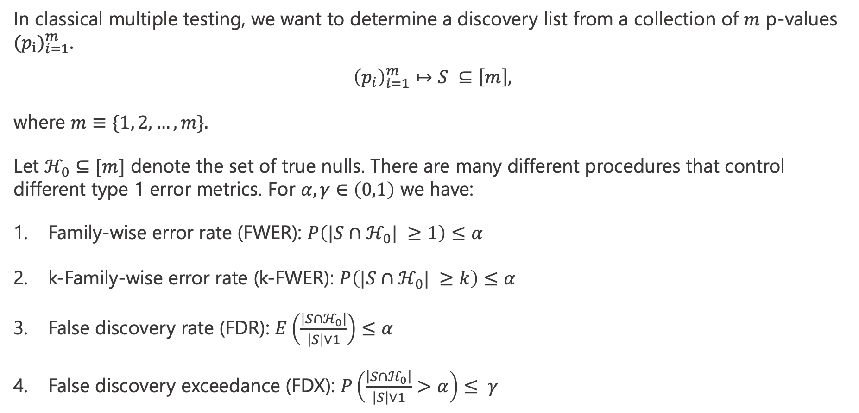
Classical problem
In classical multiple testing, we want to determine a discovery list from a collection of $m$ p-values ${(p_{i})}_{i=1}^{m}$.
$${\left(p_{i}\right)}_{i=1}^{m}↦S ⊆\left[m\right],$$
where $m≡\{1, 2, …, m\}.$
Let $ℋ_{0}⊆[m]$ denote the set of true nulls. There are many different procedures that control different type 1 error metrics. For $α,γ∈\left(0,1\right)$ we have:
Family-wise error rate (FWER): $P\left(|S∩ℋ_{0}| ≥1\right)≤α$
k-Family-wise error rate (k-FWER): $P\left(|S∩ℋ_{0}| ≥k\right)≤α$
False discovery rate (FDR): $E\left(\frac{\left|S∩ℋ_{0}\right|}{\left|S\right|∨1}\right)≤α$
False discovery exceedance (FDX): $P\left(\frac{\left|S∩ℋ_{0}\right|}{\left|S\right|∨1}>α\right)≤ γ$
Notes:
Standard testing procedures use p-values
We are interested in detecting p-values with the assistance of side information

Slide 3
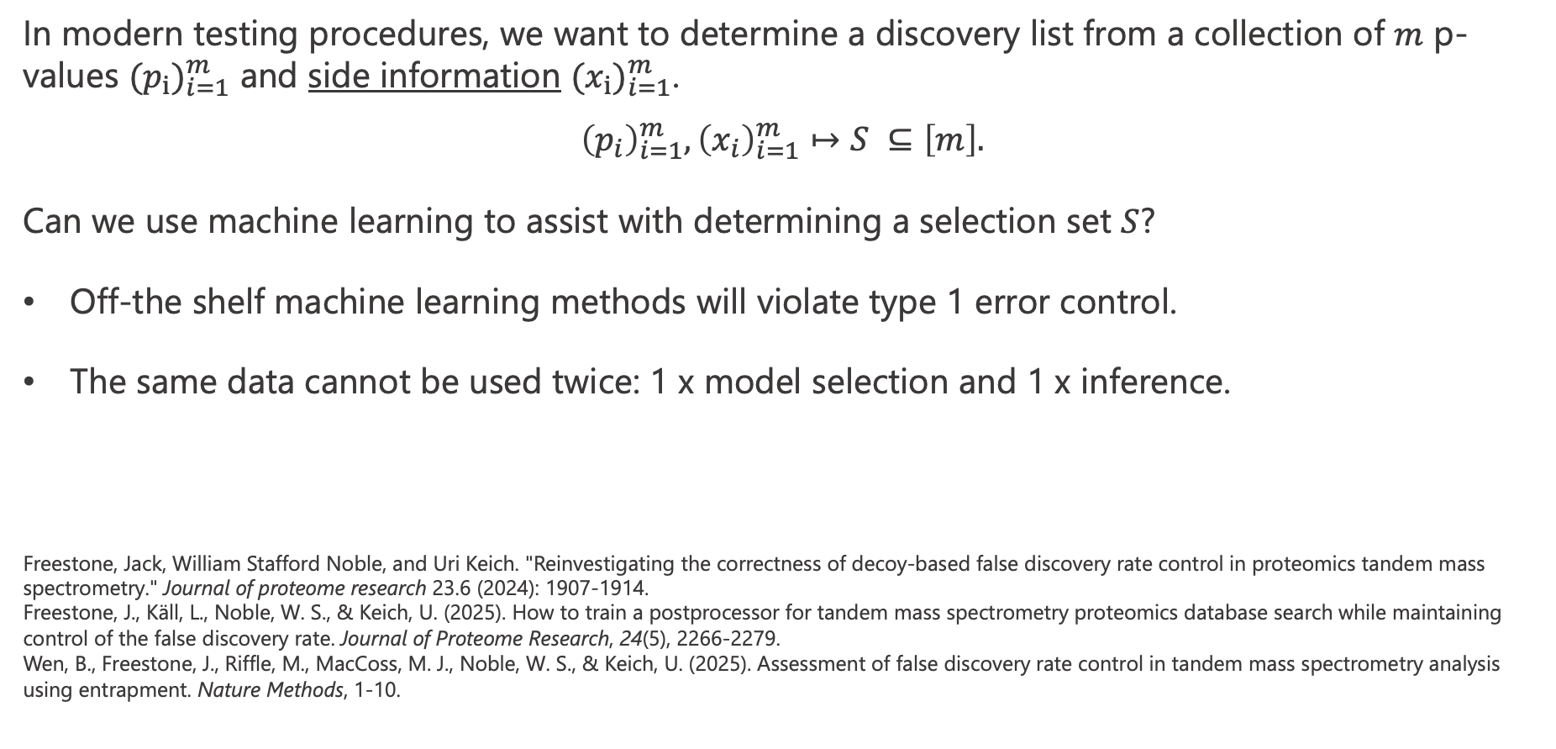
Problem statement
In modern testing procedures, we want to determine a discovery list from a collection of $m$ p-values ${(p_{i})}_{i=1}^{m}$ and side information ${(x_{i})}_{i=1}^{m}$.
$${\left(p_{i}\right)}_{i=1}^{m},{\left(x_{i}\right)}_{i=1}^{m}↦S ⊆\left[m\right].$$
Can we use machine learning to assist with determining a selection set $S$?
Off-the shelf machine learning methods will violate type 1 error control.
The same data cannot be used twice: 1 x model selection and 1 x inference.
Freestone, Jack, William Stafford Noble, and Uri Keich. "Reinvestigating the correctness of decoy-based false discovery rate control in proteomics tandem mass spectrometry." Journal of proteome research 23.6 (2024): 1907-1914. Freestone, J., Käll, L., Noble, W. S., & Keich, U. (2025). How to train a postprocessor for tandem mass spectrometry proteomics database search while maintaining control of the false discovery rate. Journal of Proteome Research, 24(5), 2266-2279. Wen, B., Freestone, J., Riffle, M., MacCoss, M. J., Noble, W. S., & Keich, U. (2025). Assessment of false discovery rate control in tandem mass spectrometry analysis using entrapment. Nature Methods, 1-10.
Notes:
- RESET Framework

Slide 4

RESET: REScoring via Estimating and Training
Step 1: Reflect the p-values above $p=½$.
Notes:
RESET Framework
P-value conversion
Sample accordingly and hide
Rescoring

Slide 5
RESET: REScoring via Estimating and Training
Step 2: Convert the resulting p-values to z-scores.
Notes:
RESET Framework
P-value conversion
Sample accordingly and hide
Rescoring

Slide 6
RESET: REScoring via Estimating and Training
Step 3: Randomly sample half the negative labels.
Notes:
RESET Framework
P-value conversion
Sample accordingly and hide
Rescoring

Slide 7
RESET: REScoring via Estimating and Training
Step 4: Turn the selected negative labels to positive labels.
Notes:
RESET Framework
P-value conversion
Sample accordingly and hide
Rescoring

Slide 8
RESET: REScoring via Estimating and Training
Step 5: Fit any classification ML using side information and score as predictors and labels as response.
Notes:
RESET Framework
P-value conversion
Sample accordingly and hide
Rescoring

Slide 9
RESET: REScoring via Estimating and Training
Step 7: Throw out the negative labels used for training.
Notes:
RESET Framework
P-value conversion
Sample accordingly and hide
Rescoring

Slide 10
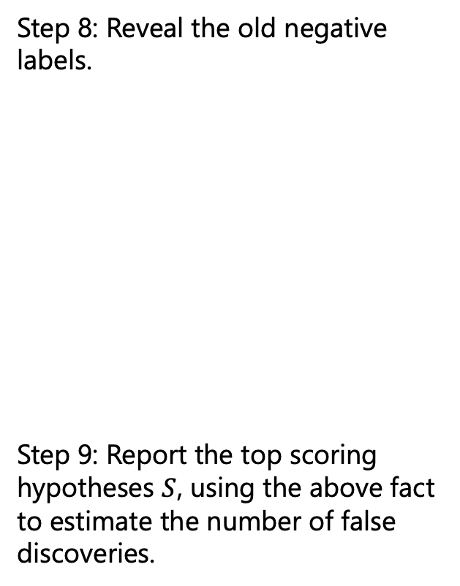
RESET: REScoring via Estimating and Training
Step 8: Reveal the old negative labels.
Step 9: Report the top scoring hypotheses $S$, using the above fact to estimate the number of false discoveries.
$$2⋅\#\{L_{i}=−1\}≈\#\{L_{i}=+1, i ∈ℋ_{0}\}$$
Notes:
RESET Framework
P-value conversion
Sample accordingly and hide
Rescoring

Slide 11
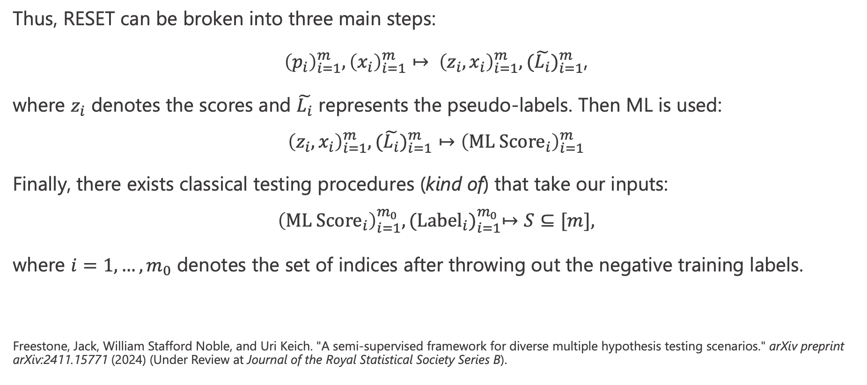
RESET: REScoring via Estimating and Training
Thus, RESET can be broken into three main steps:
${\left(p_{i}\right)}_{i=1}^{m},{\left(x_{i}\right)}_{i=1}^{m}↦ {\left(z_{i},x_{i}\right)}_{i=1}^{m}, ({\tilde{L_{i}})}_{i=1}^{m}$,
where $z_{i}$ denotes the scores and $\tilde{L_{i}}$ represents the pseudo-labels. Then ML is used:
$${\left(z_{i},x_{i}\right)}_{i=1}^{m}, ({\tilde{L_{i}})}_{i=1}^{m}↦{\left({ML Score}_{i}\right)}_{i=1}^{m}$$
Finally, there exists classical testing procedures (kind of) that take our inputs:
$${\left({ML Score}_{i}\right)}_{i=1}^{m_{0}}, {({Label}_{i})}_{i=1}^{m_{0}}↦S⊆[m],$$
where $i=1,…,m_{0}$ denotes the set of indices after throwing out the negative training labels.
Freestone, Jack, William Stafford Noble, and Uri Keich. "A semi-supervised framework for diverse multiple hypothesis testing scenarios." arXiv preprint arXiv:2411.15771 (2024) (Under Review at Journal of the Royal Statistical Society Series B).
Notes:
- Idea in simulations

Slide 12
RESET: REScoring via Estimating and Training
Notes:
RESET Framework
P-value conversion
Sample accordingly and hide
Rescoring

Slide 13
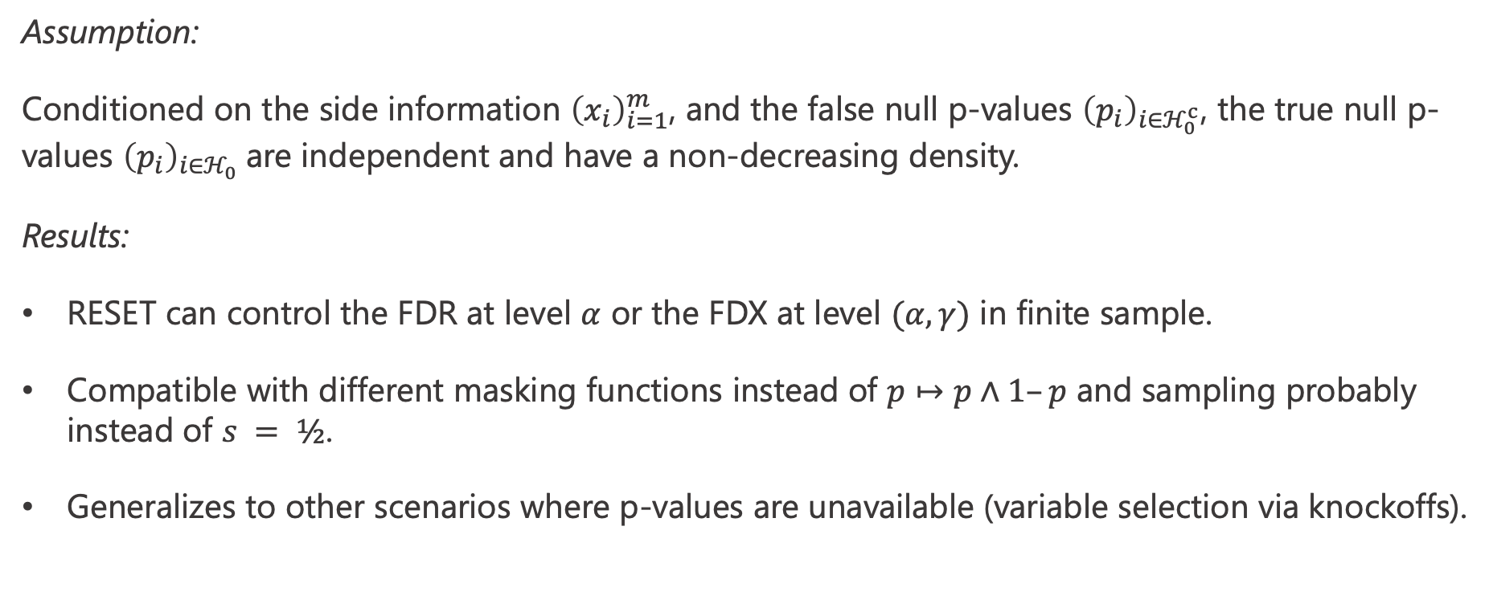
Theoretical properties
Assumption:
Conditioned on the side information ${\left(x_{i}\right)}_{i=1}^{m}$, and the false null p-values ${\left(p_{i}\right)}_{i∈ℋ_{0}^{c}}$, the true null p-values ${\left(p_{i}\right)}_{i∈ℋ_{0}}$are independent and have a non-decreasing density.
Results:
RESET can control the FDR at level $α$ or the FDX at level $(α, γ)$ in finite sample.
Compatible with different masking functions instead of $p↦p∧1–p$ and sampling probably instead of $s = ½$.
Generalizes to other scenarios where p-values are unavailable (variable selection via knockoffs).
Notes:
- RESET Ensemble

Slide 14
If time permits: RESET Ensemble
Split the data into K folds (K = 3).
Train each ML classification algorithm on two folds and apply to test fold.
Estimate the number of discoveries in each test fold.
Select the best one (Random Forest in this case).
Use the Random Forest scores from the test folds.
TEST FOLDS | FOLD 1 | FOLD 2 | FOLD 3
Random Forest | 1000 | 1100 | 900
Neural Network | 500 | 400 | 300
Generalized Additive Model | 600 | 700 | 500
Notes:
Do CV

Slide 15
Numerical Simulation
Notes:
- Real data examples

Slide 16
Comparison to other methods
Method | Controls FDR? | Comp. time
AdaPT (Lei & Fithian 2018) | Finite | Slow
AdaPT_{g} (Chao & Fithian 2018) | Finite | Slow
AdaPT-GMM_{g} (Chao & Fithian 2018) | Finite | Slow
AdaFDR (Zhang, Xia, Zou 2019) | Asymptotic (FDP) | Fast
ZAP-Asymp (Leung & Sun 2022) | Asymptotic | Fast
RESET | Finite | Fast

Slide 17
Real data
We used many real-world datasets ranging from:
3 RNA-Seq datasets
Proteomics dataset
2 Microbiome datasets
2 fMRI datasets
2 Gene-drug response datasets
Notes:
- FDX control extension

Slide 18
Real data

Slide 19
Real data
Notes:
- Extension to selecting c, lambda (current student)

Slide 20
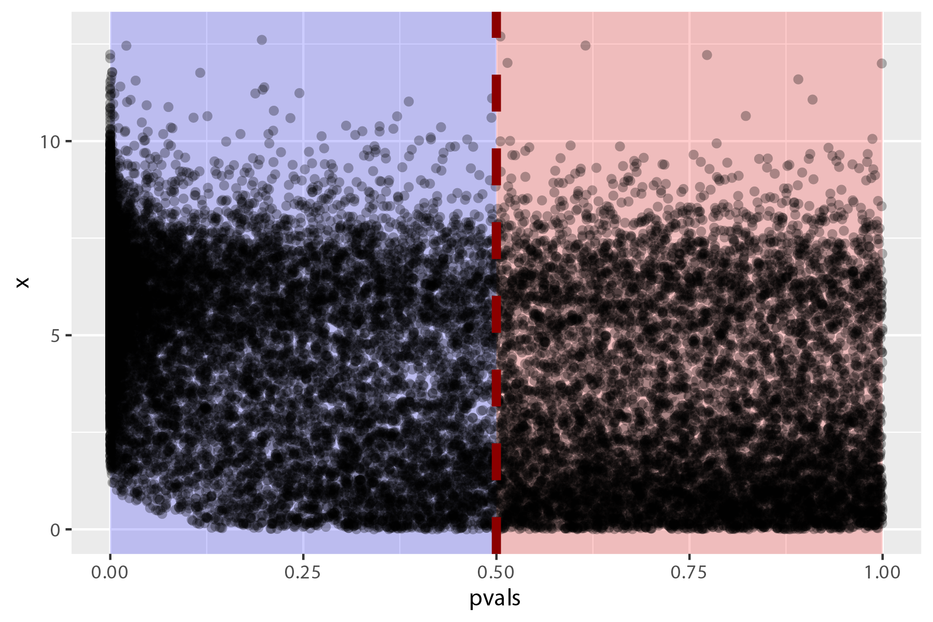
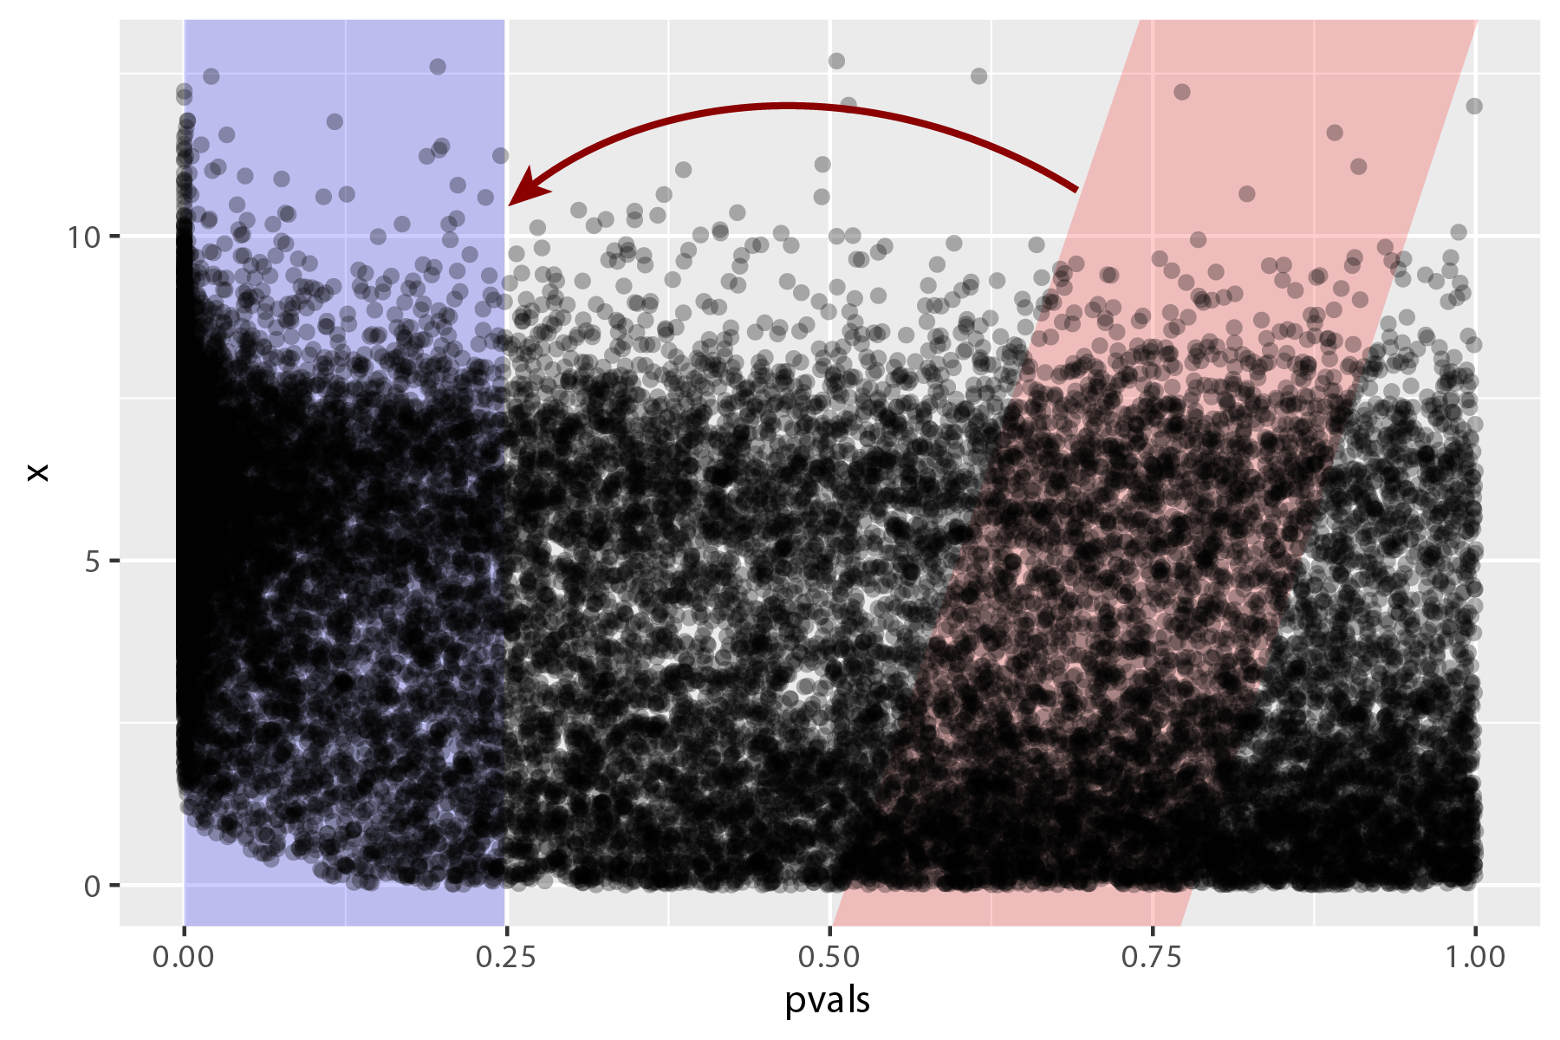
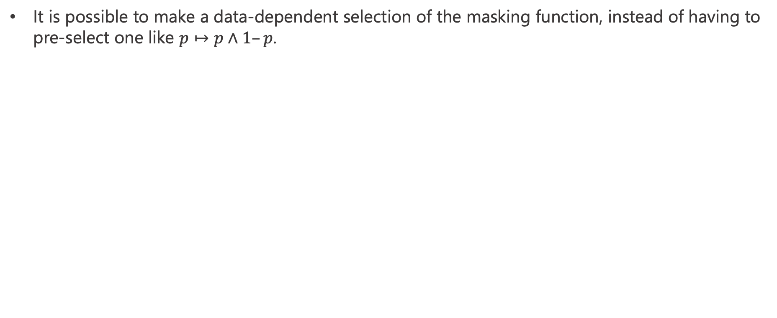
If time permits: further work
It is possible to make a data-dependent selection of the masking function, instead of having to pre-select one like $p↦p∧1–p$.
Notes:
- References

Slide 21
Additional References
Lei, Lihua, and William Fithian. "AdaPT: an interactive procedure for multiple testing with side information." Journal of the Royal Statistical Society Series B: Statistical Methodology 80.4 (2018): 649-679.
Chao, Patrick, and William Fithian. "AdaPT-GMM: Powerful and robust covariate-assisted multiple testing." arXiv preprint arXiv:2106.15812 (2021).
Zhang, Martin J., Fei Xia, and James Zou. "Fast and covariate-adaptive method amplifies detection power in large-scale multiple hypothesis testing." Nature communications 10.1 (2019): 3433.
Leung, Dennis, and Wenguang Sun. "ZAP: Z Z‐value adaptive procedures for false discovery rate control with side information." Journal of the Royal Statistical Society: Series B (Statistical Methodology) 84.5 (2022): 1886-1946.

